Slide 1
DEPNotify...
LAA Dec 2018
Mark Lamont

Slide 2
About me
Notes:
Not always been in IT CLICK ONCE
RAF for 18 years, left in 97
CNE MCSE etc
Worked Railtrack - now network rail
worked Transco
A few other places.
Carlton TV 2001 → became ITV 2005 → outsourced into Accenture 2010
Touched first mac in late 2010

Slide 3
About me II
Slack: Mark_lamont
Blog: https://montysmacmusings.wordpress.com/
Github: https://github.com/PhantomPhixer/Phixits
Notes:
my web links
occasional blog and some github code bits mainly linked from the blog

Slide 4
Why am I here?
Not a philosophical question!
Neil Martin’s presentation at Jamf roadshow:
looked into DEPNotify - Started using it for DEP build process
Started using DEPNotify for other things
Published a blog article about this
Notes:
jamf roadshow watched Neils presentation CLICK EACH LINE
started using depnotify for dep
started using for other notifications
published a blog, got asked to speak

Slide 5
What is DEPNotify?
DEPNotify is a small lightweight notification app that was designed to let your users know what's going on during a DEP enrollment.
The app is focused on being very simple to use and easy to deploy.
https://gitlab.com/Mactroll/DEPNotify

Slide 6
Alternatives?
mac@ibm
Splashbuddy
Local bespoke apps
jamfHelper
Notes:
not a discussion of pros and cons of any of these
not actually tried most

Slide 7
How do ITV use DEPNotify?
DEP build progress screens
Large install progress and cover screen
Compliance nag screen
Notes:
standard use for DEP builds CLICK EACH LINE
covering and informing for long installs or ones with a restart
nagging users to do things

Slide 8
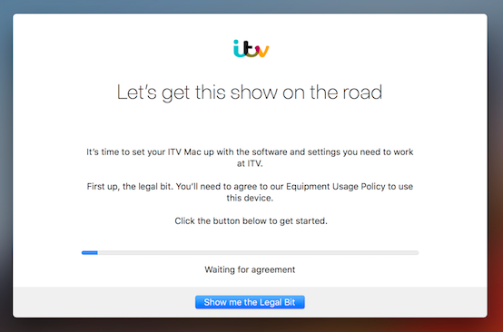
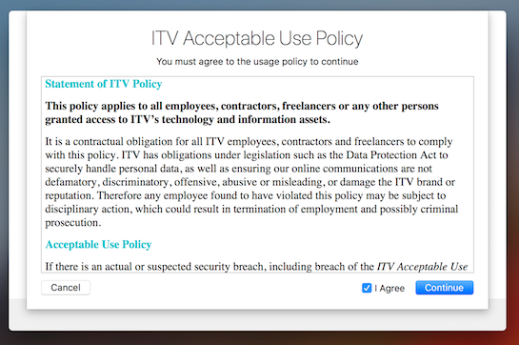
DEP build: AUP screens
AUP screen as the first step
Notes:
start with simple splash screen leading to AUP screen. AUTO ADVANCE
don’t need the registration screen option yet
The RTF EULA/AUP screen added at my request
then a succession of informative screens. ***** NEXT SLIDE *****

Slide 9
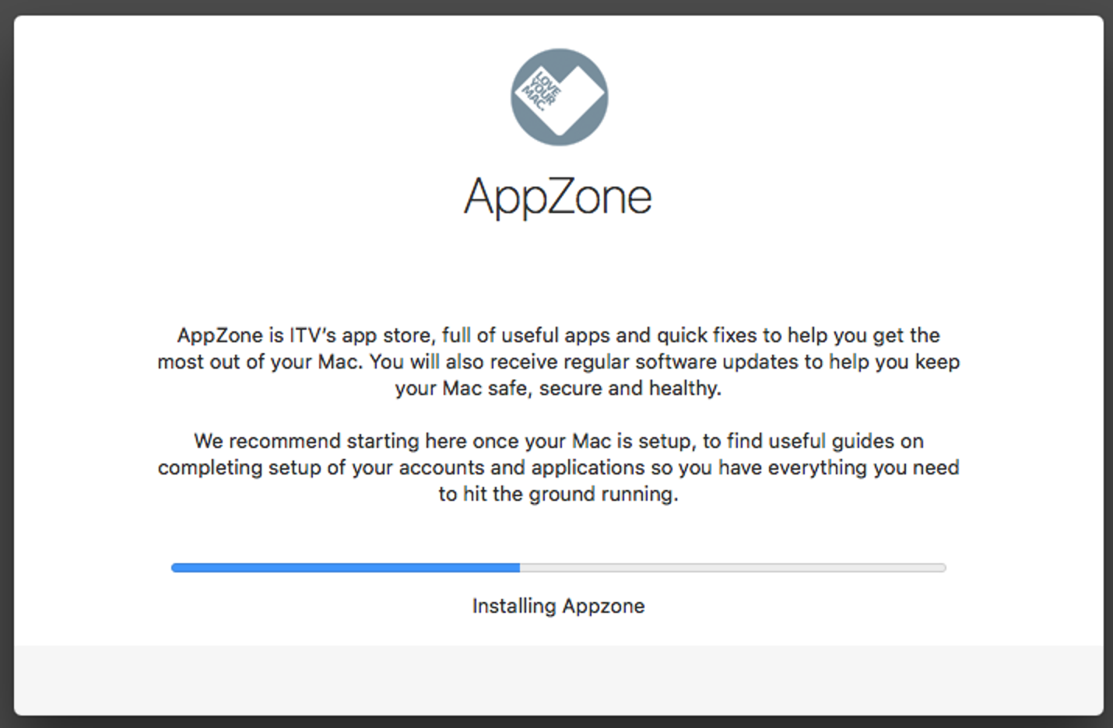
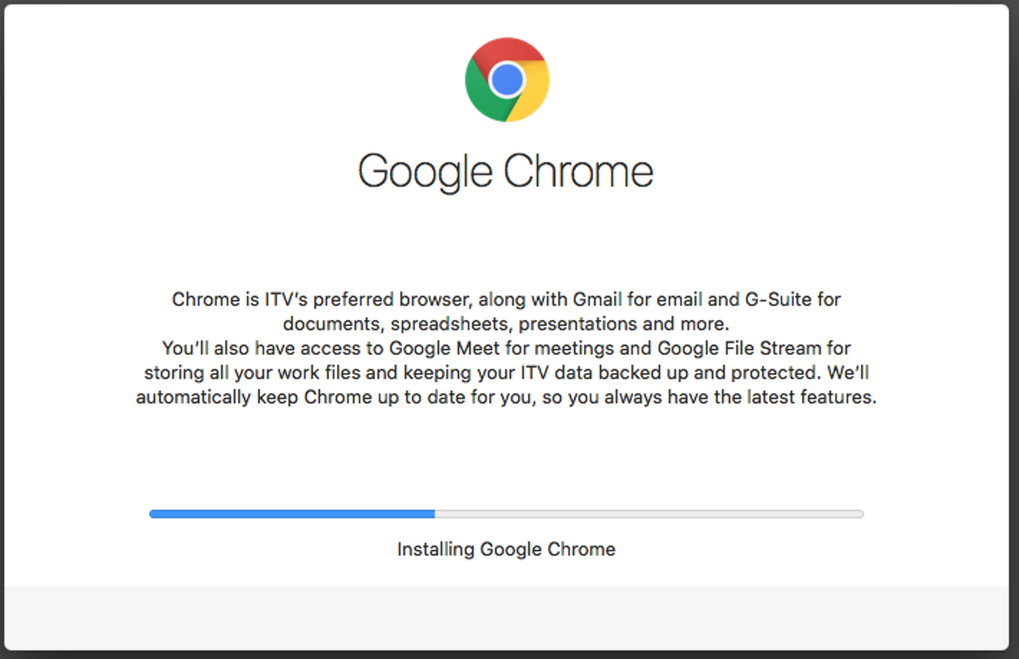
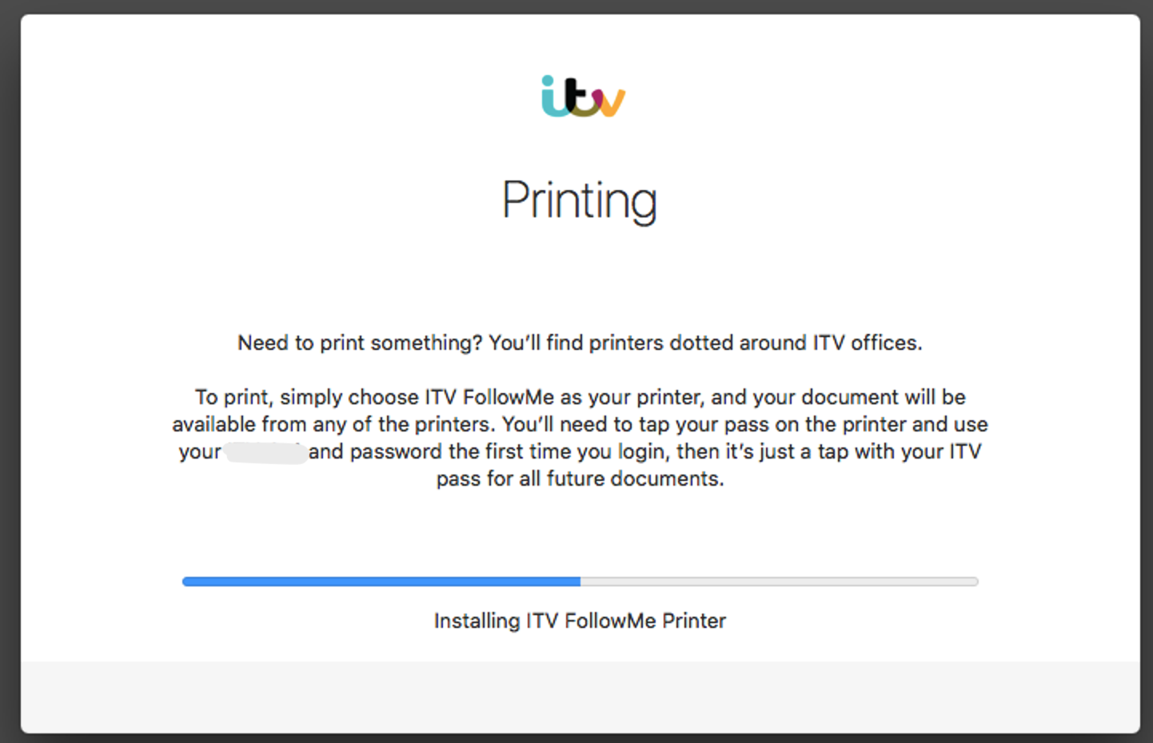
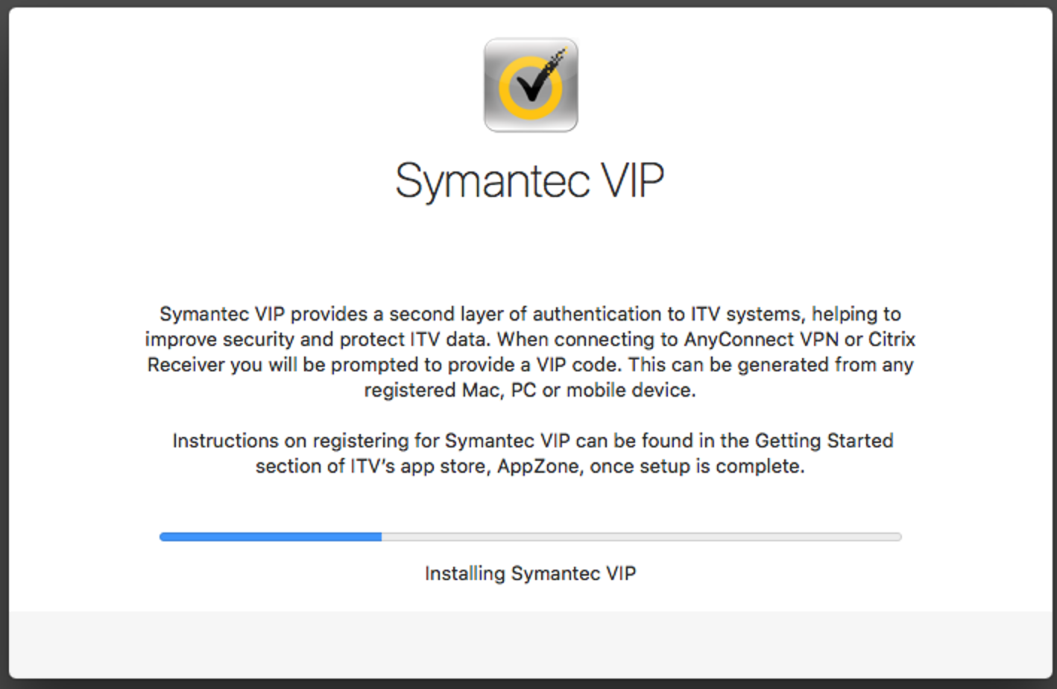
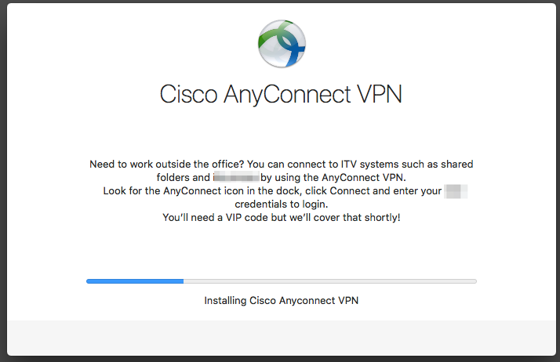
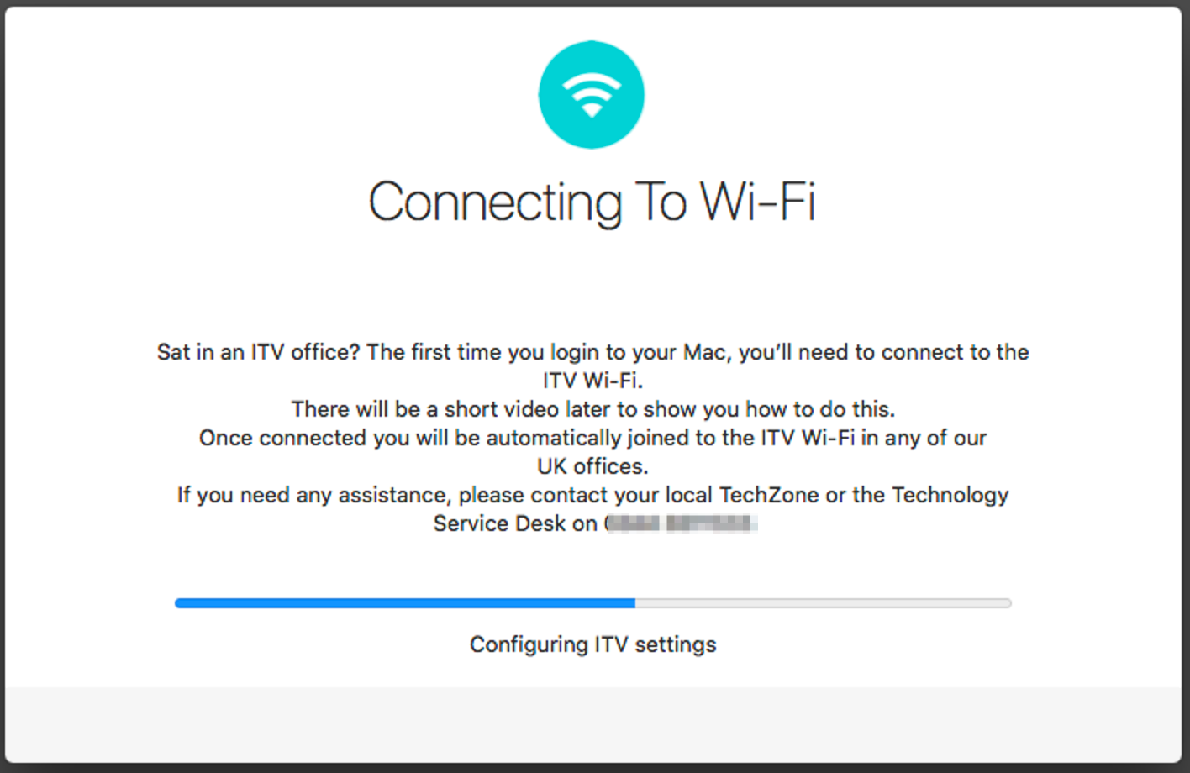
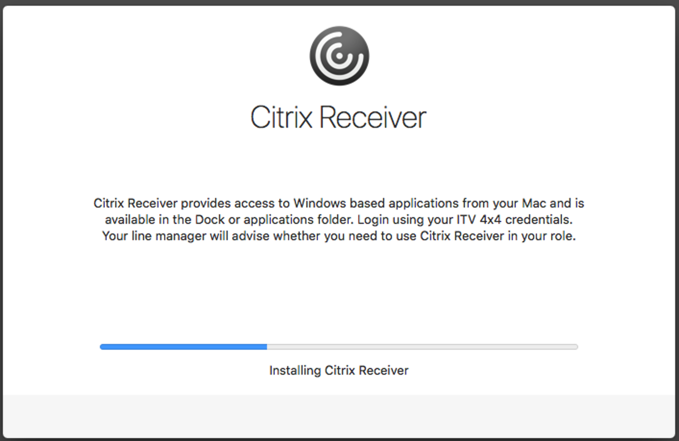
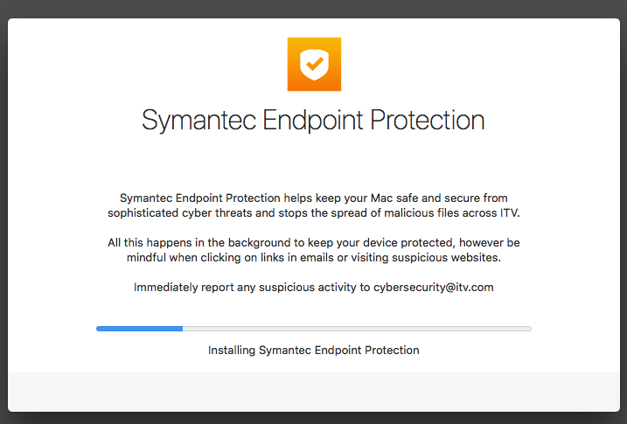
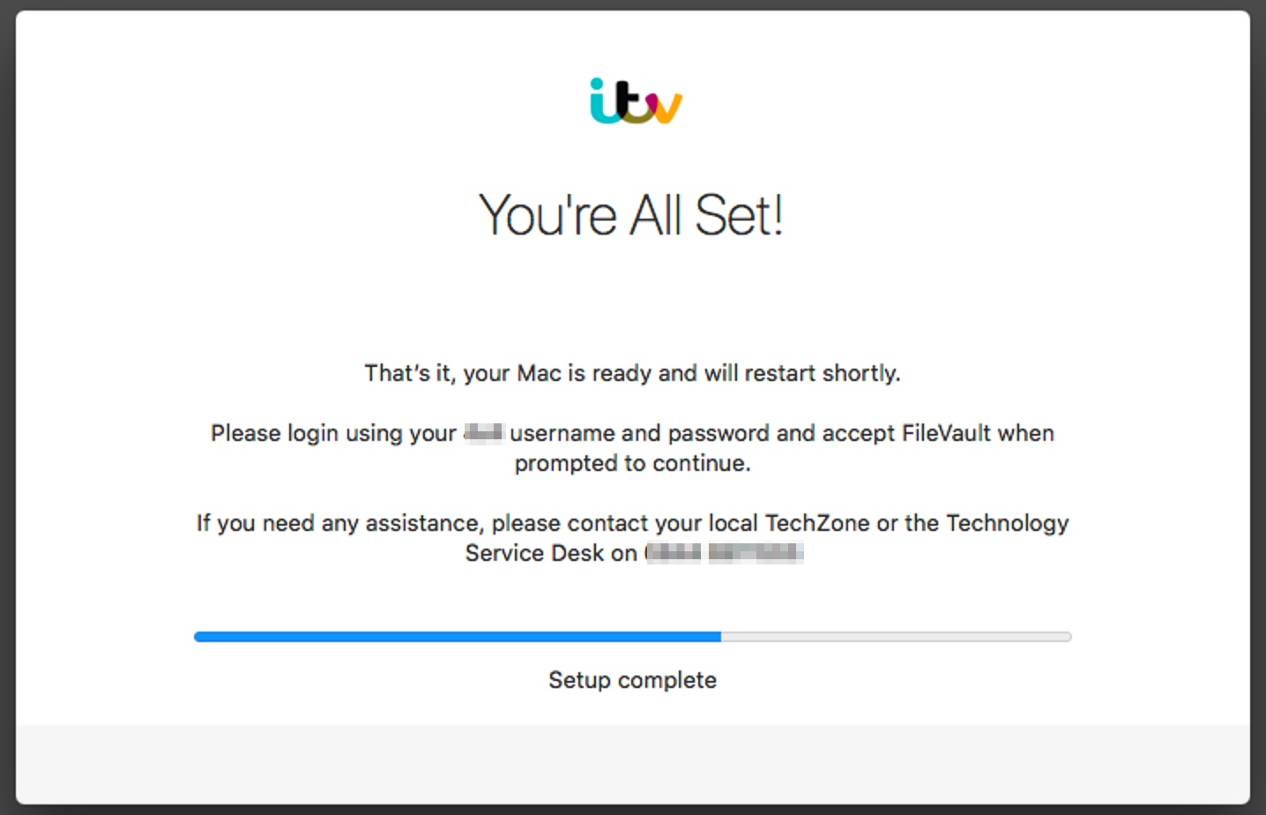
DEP build: progress screens
Notes:
informative but covering up a lot. AUTO ADVANCE
not just what is displayed can be done behind the screen

Slide 10
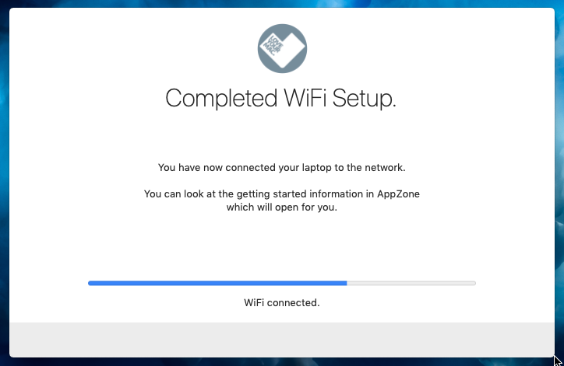
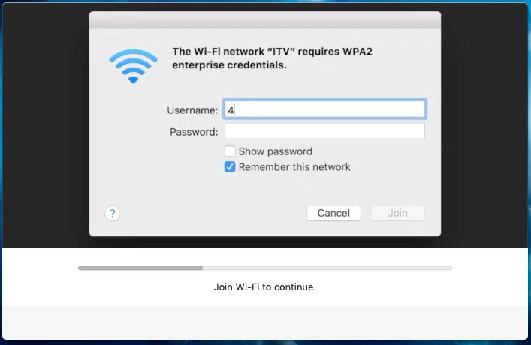
DEP build: First step video
DEPNotify can display:
Text
Images
Video
Web
Local
In the build use this after first logon to show how to connect to wifi
Notes:
we have separate DEP only wifi CLICK ONCE SHOW TEXT AND FIRST IMAGE.
remove this as part of the build to force login to company wifi
show video of how and confirm it’s done in the one depnotify window CLICK AGAIN TO SHOW END

Slide 11
A bit of Bash
EULA_Screen_Settings_Load (){
echo "Command: MainTitle: Let’s get this show on the road" >> "$DepNotifyWorkingDir"depnotify.log
echo "Command: ContinueButtonEULA: Show me the Legal Bit" >> "$DepNotifyWorkingDir"depnotify.log
echo "Command: MainText: It’s time to set your ITV Mac up with the software and settings you need to work at ITV. \n \nFirst up, the legal bit. You’ll need to agree to our Equipment Usage Policy to use this device. \n \n Click the button below to get started." >> "$DepNotifyWorkingDir"depnotify.log
echo "Command: Image: "/Library/ITVManagement/Assets/Pictures/itv_white_circle.png"" >> "$DepNotifyWorkingDir"depnotify.log
echo "Status: Waiting for agreement" >> "$DepNotifyWorkingDir"depnotify.log
}
Notes:
easy to use. CLICK TO DISPLAY GRAPHIC
echo commands into a file before it runs and during the run

Slide 12
A bit more Bash
############################
# install symantec VIP. #
############################
echo "Command: MainTitle: Symantec VIP" >> "$DepNotifyWorkingDir"depnotify.log
echo "Command: MainText: Symantec VIP provides a second layer of authentication to ITV systems, helping to improve security and protect ITV data. When connecting to AnyConnect VPN or Citrix Receiver you will be prompted to provide a VIP code. This can be generated from any registered Mac, PC or mobile device. \n \n Instructions on registering for Symantec VIP can be found in the Getting Started section of ITV’s app store, AppZone, once setup is complete." >> "$DepNotifyWorkingDir"depnotify.log
echo "Status: Installing Symantec VIP" >> "$DepNotifyWorkingDir"depnotify.log
echo "Command: Image: "/Library/ITVManagement/Assets/Pictures/symantec.png"" >> "$DepNotifyWorkingDir"depnotify.log
jamf policy -event install_vip_live
sleep 5
Notes:
sample screen change and policy deploy CLICK TO DISPLAY GRAPHIC
use several blocks like this
multiple polices can be deployed behind each screen

Slide 13
General large install progress screen
Used for:
Informing users when a long install is running
Run by:
Script in jamf policy
Messaging set by variables
Notes:
lets users know install is running CLICK MULTIPLE TO ADVANCE
one script multiple uses

Slide 14
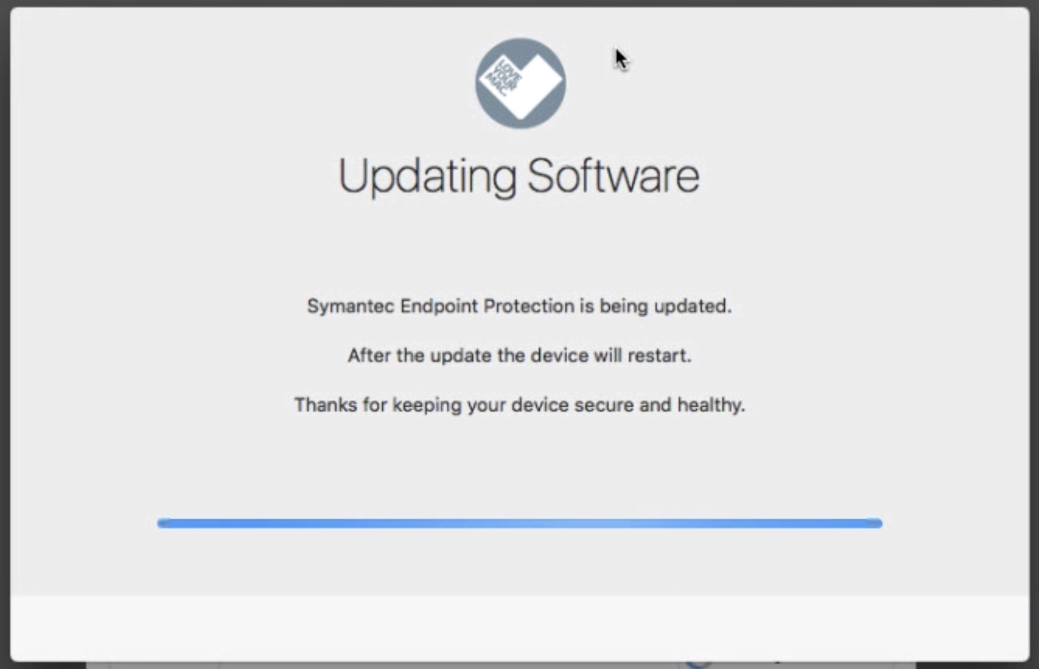
General large install progress screen
Example screen
Upgrading antivirus
Notes:
Takes a while so just keeps user focused that something is going on.
NO ANIMATION
Looks nicer that jamf helper

Slide 15
Compliance nag screen
What does it do?
Soft nag (windowed - short delay) for a number of times, settable by script.
Hard nag (full screen - longer delay) after soft nag.
Send an admin Slack message after set number of times.
Run by:
Script in jamf policy
Messaging, soft nag limit and slack details set in script variables
Policy set to open AppZone (Self Service) to show user the policy
Notes:
used as a “please do this” nag. CLICK EACH LINE
Gets more annoying after a while
Sends admin messages after more ignores

Slide 16
Nag screen and install screen in action
Notes:
live demo time!

Slide 17
Links
My Blog article https://montysmacmusings.wordpress.com/2018/10/25/depnotify-makes-a-great-user-nag-screen/
Neils DEPNotify blog
https://soundmacguy.wordpress.com/2018/05/17/lab-nauseam-dawn-of-the-dep/
DEPNotify
https://gitlab.com/Mactroll/DEPNotify

Slide 18
Questions?

